Slide 1
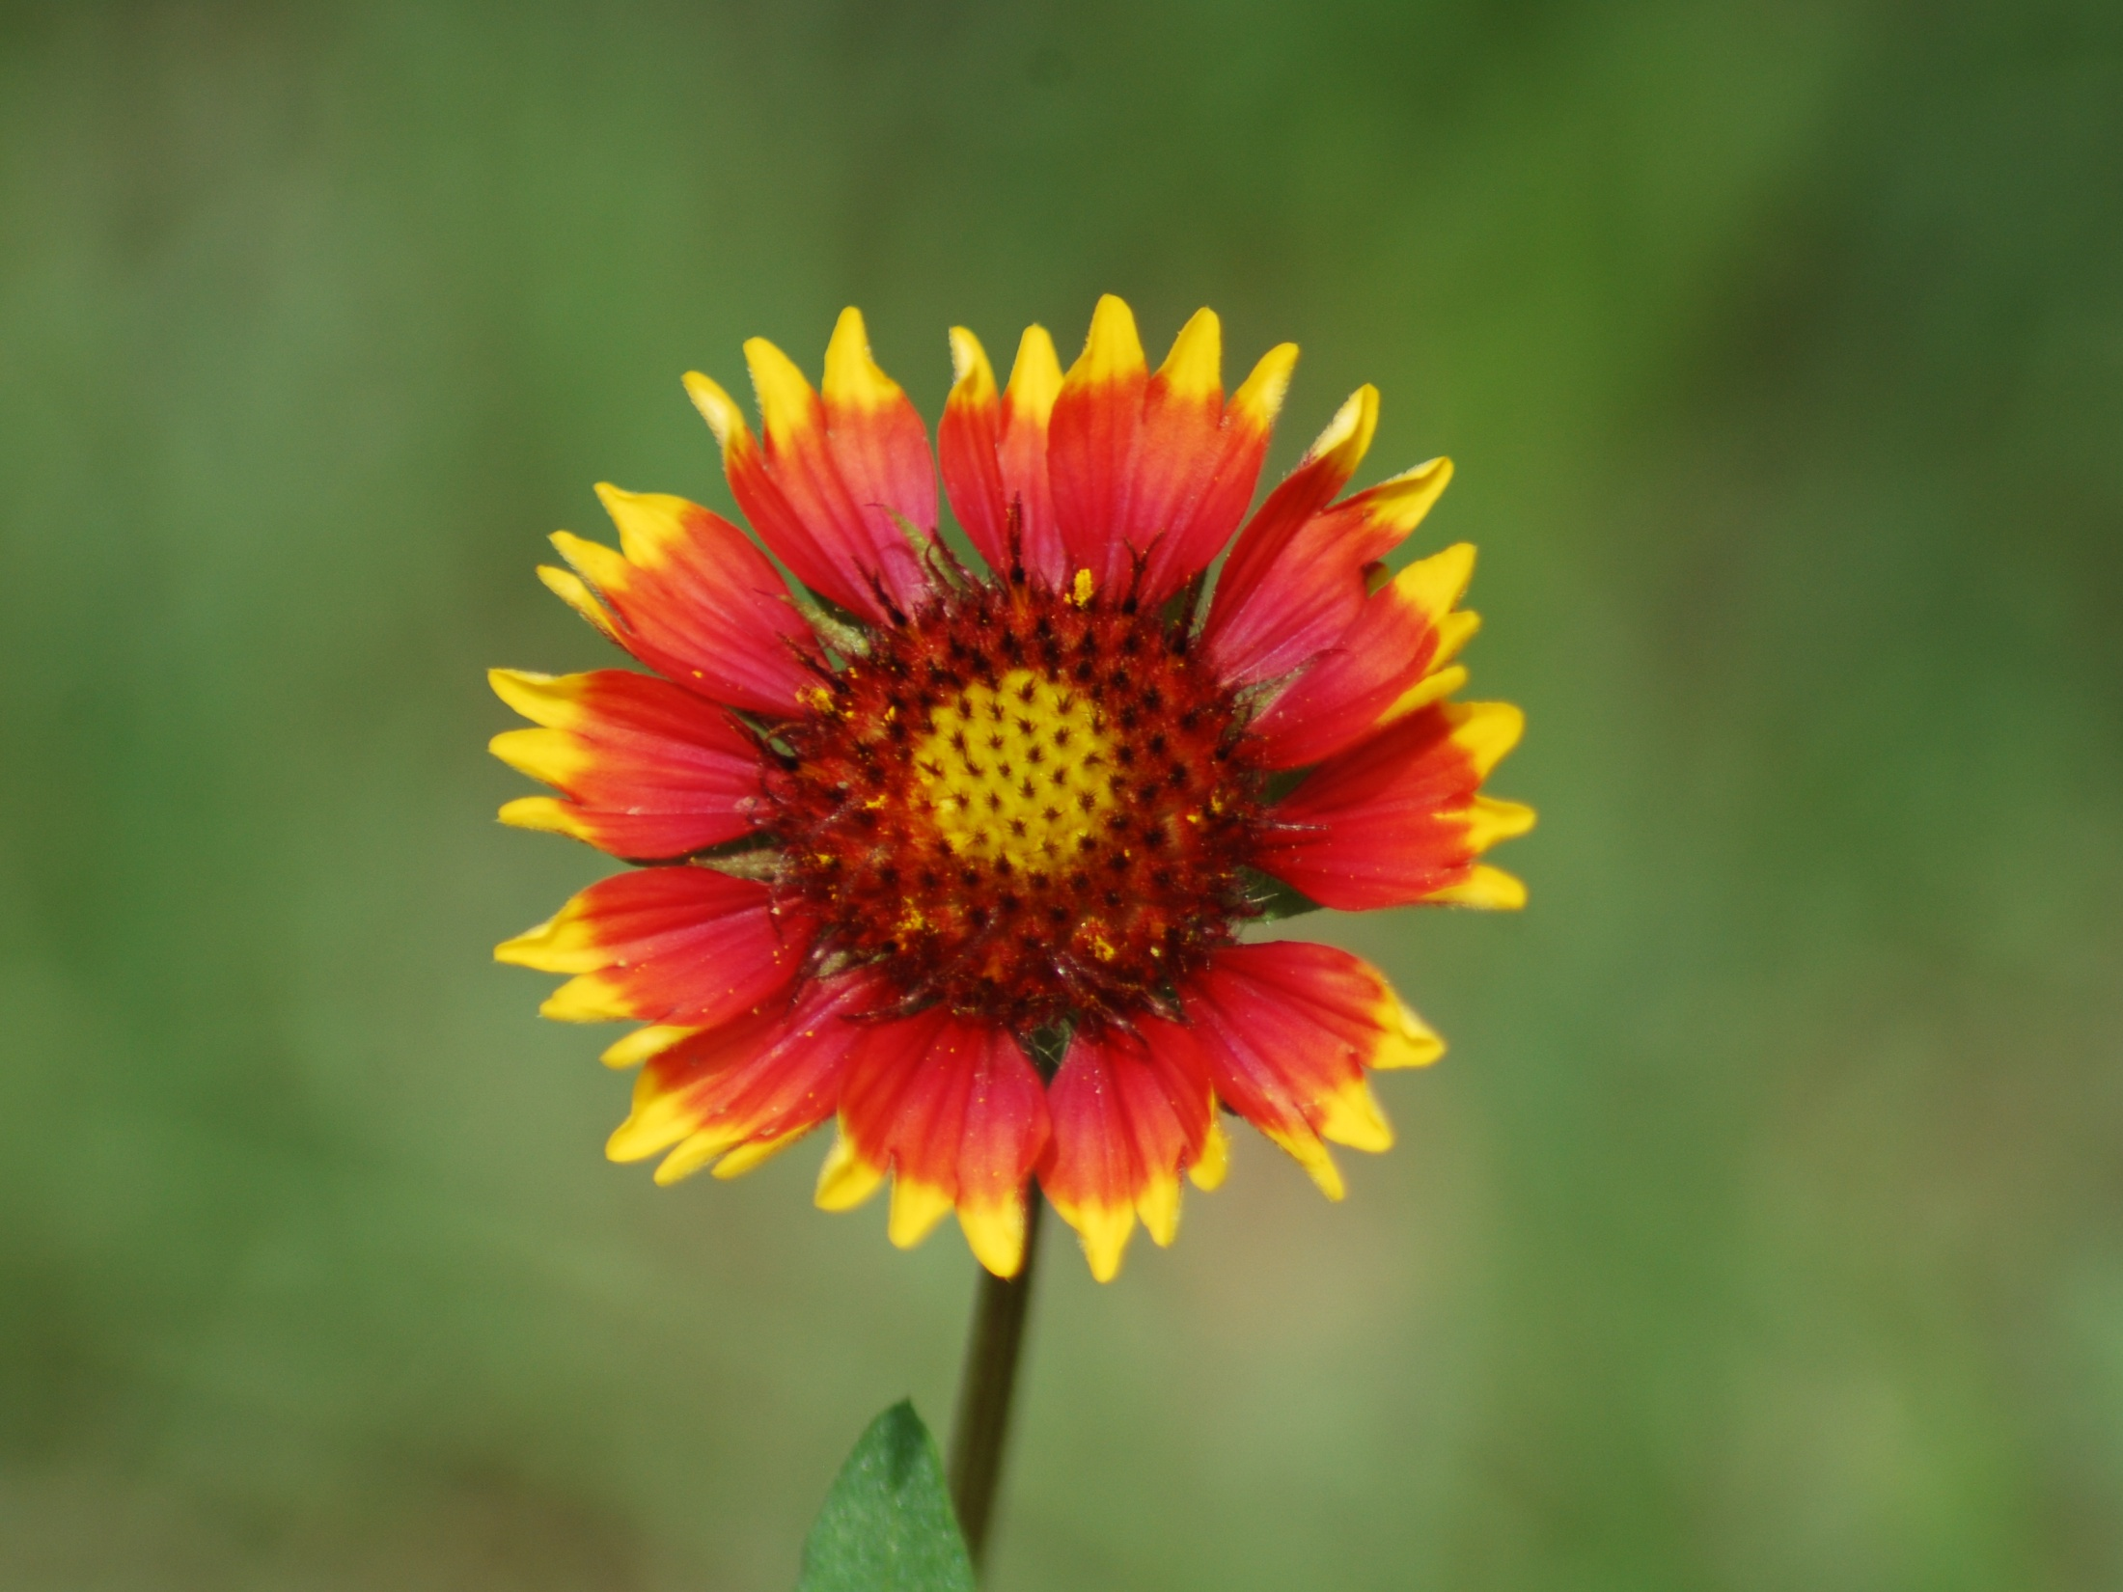
Barber County Wildflower Tour
Saturday, May 11, 2013
Medicine Lodge High School
Medicine Lodge, KS
Photo Provided by Courtney Pilkington

Slide 2
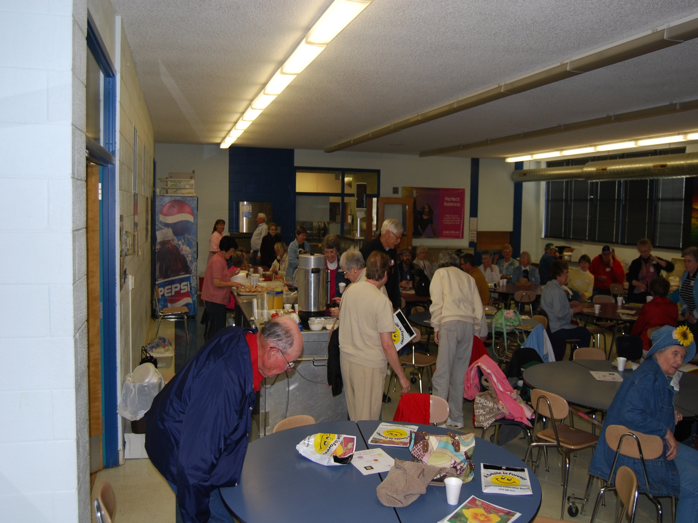
Registration & Continental Breakfast of Cinnamon Rolls, Fruit, Juice & Coffee
8:30 a.m.
Photo Provided by Courtney Pilkington

Slide 3
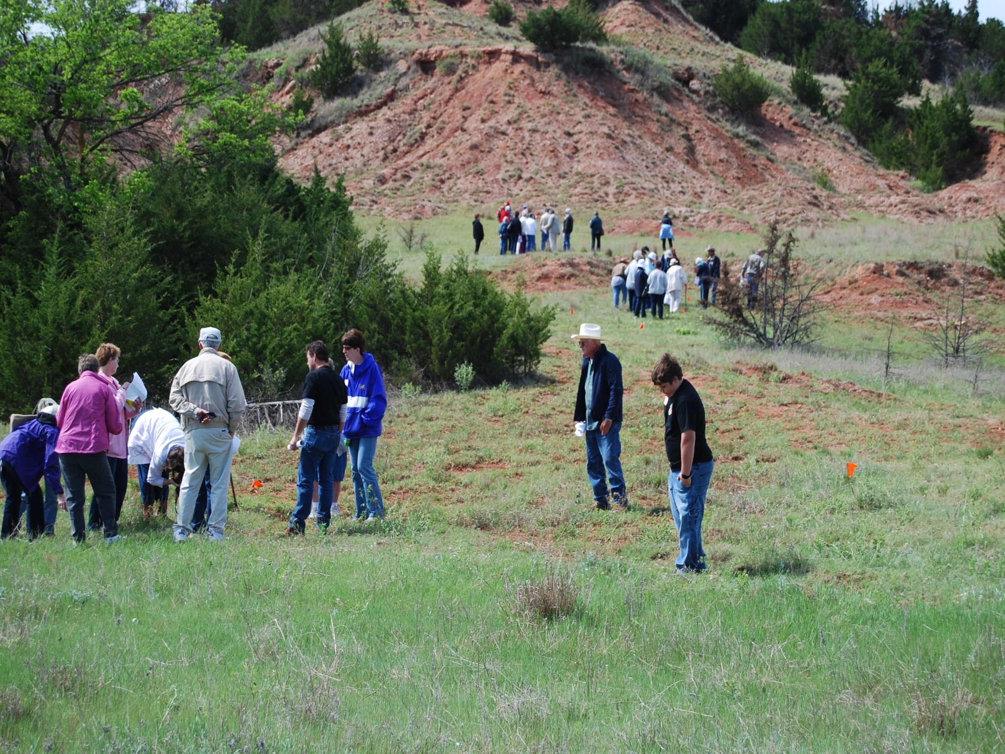
Guide Introductions, Introduction to the Tour, and a Short PowerPoint are Presented Before Heading to the First Site.
Photo Provided by Courtney Pilkington

Slide 4
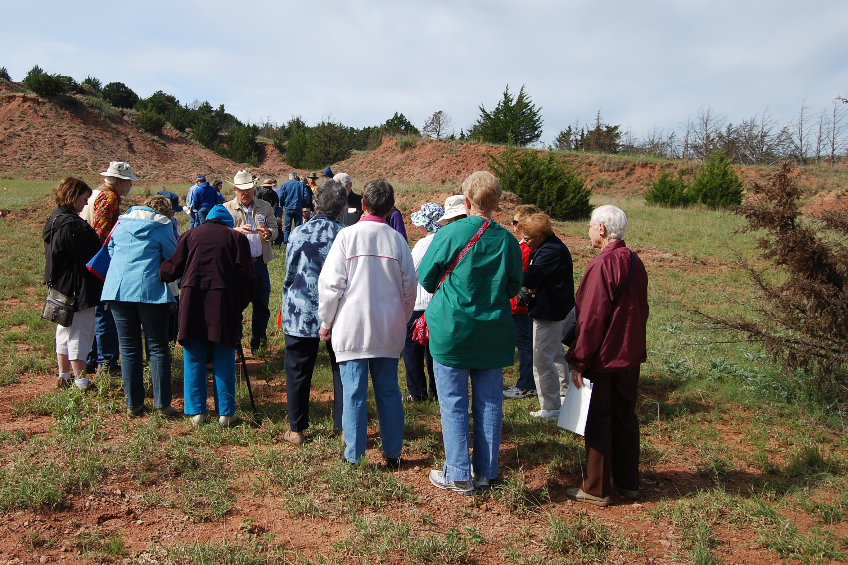
Knowledgeable Tour Guides Educate Tour Goers at the First Site.
Photo Provided by Courtney Pilkington

Slide 5
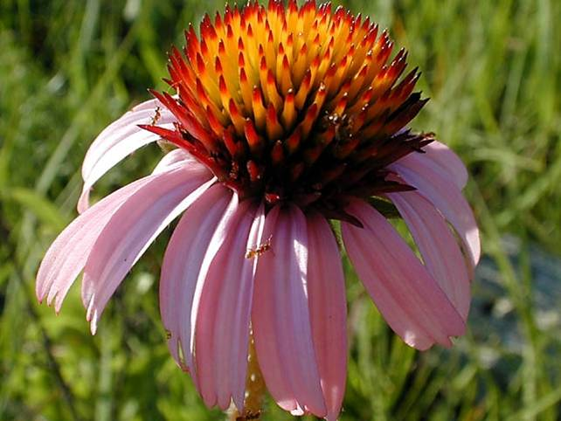
BLACK SAMPSON
Photo Provided by Mike Haddock, KSU

Slide 6
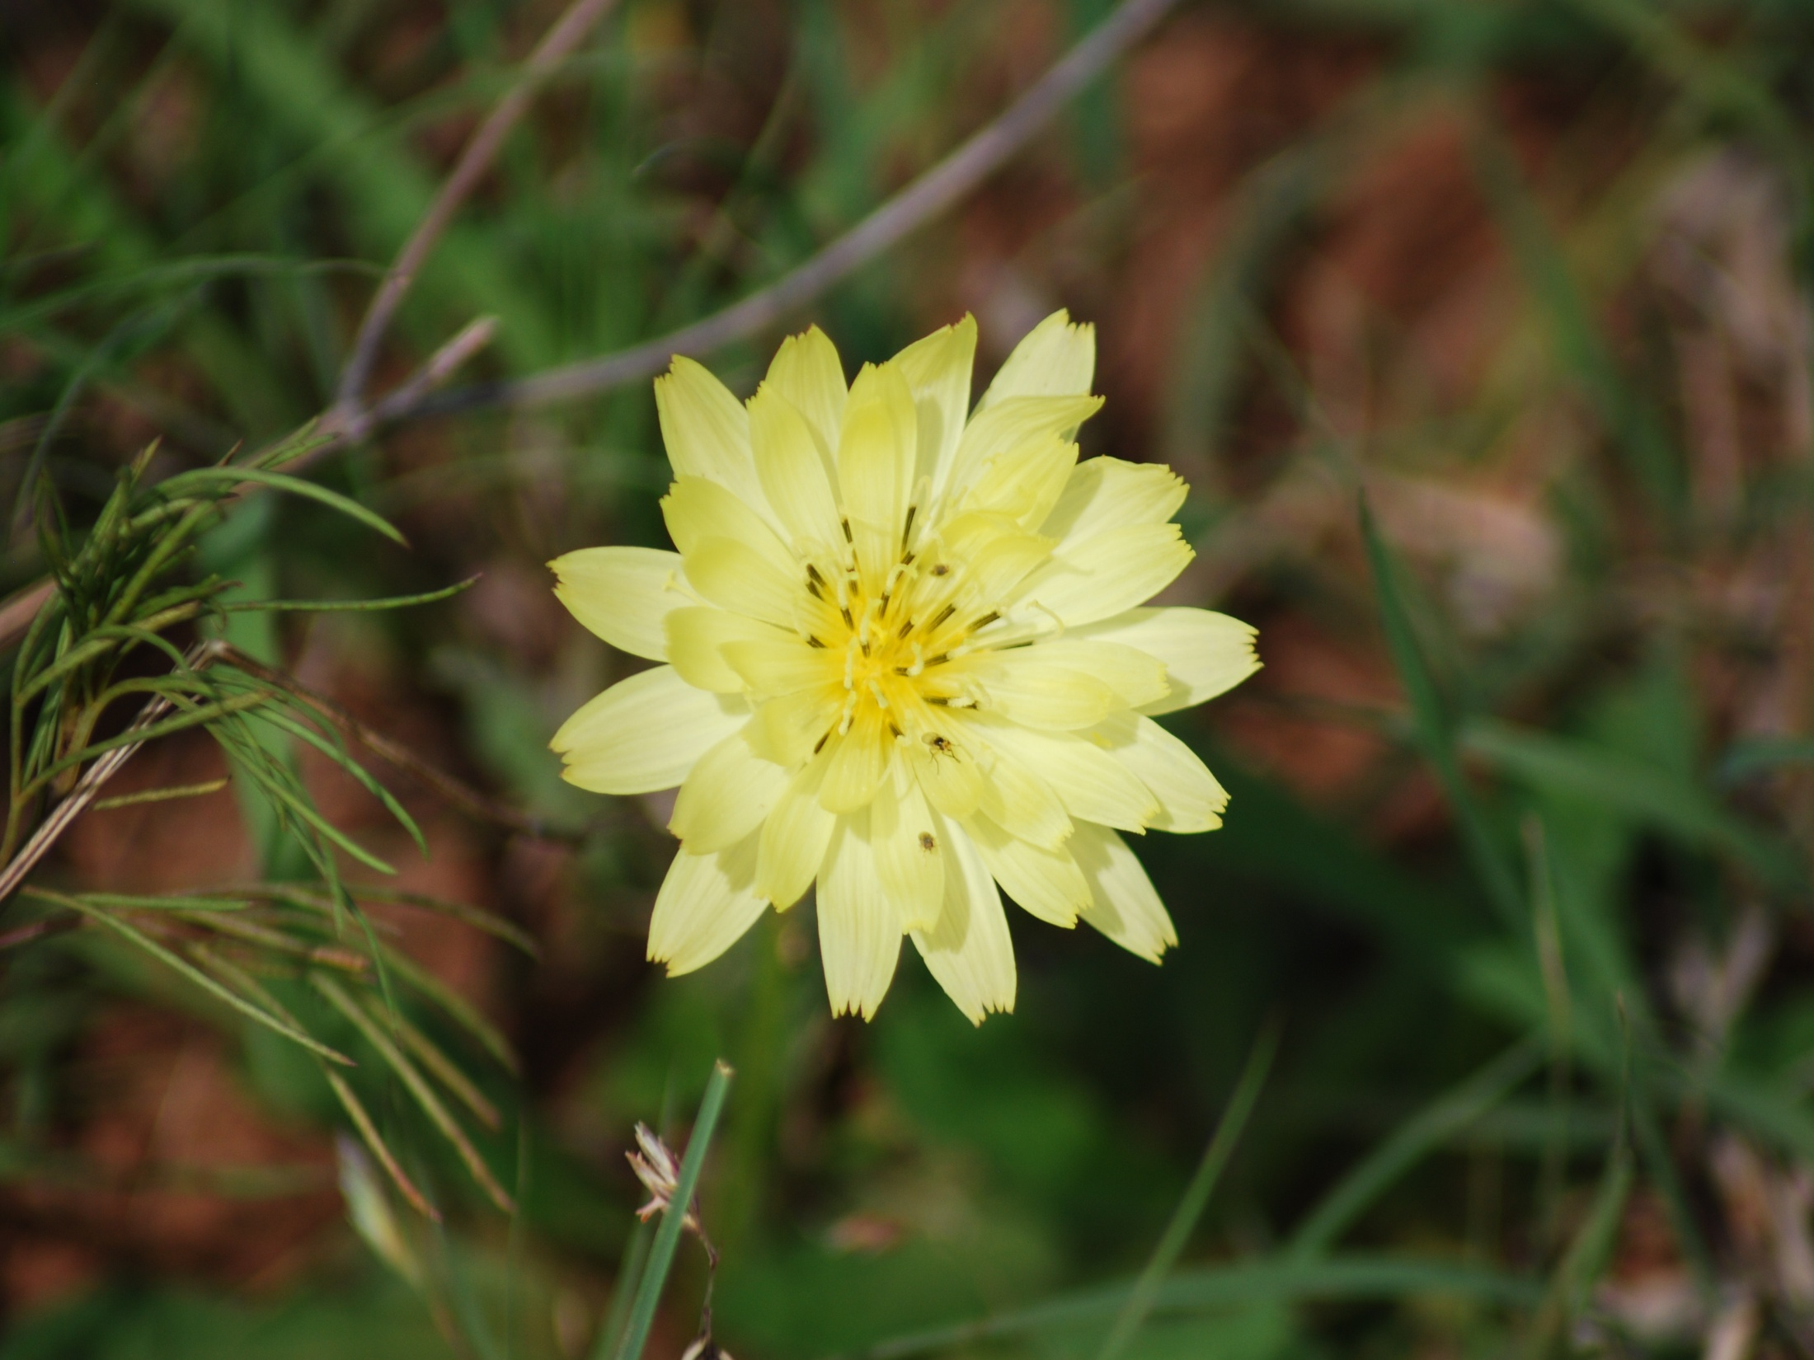
FALSE DANDELION
Photo Provided by Courtney Pilkington

Slide 7
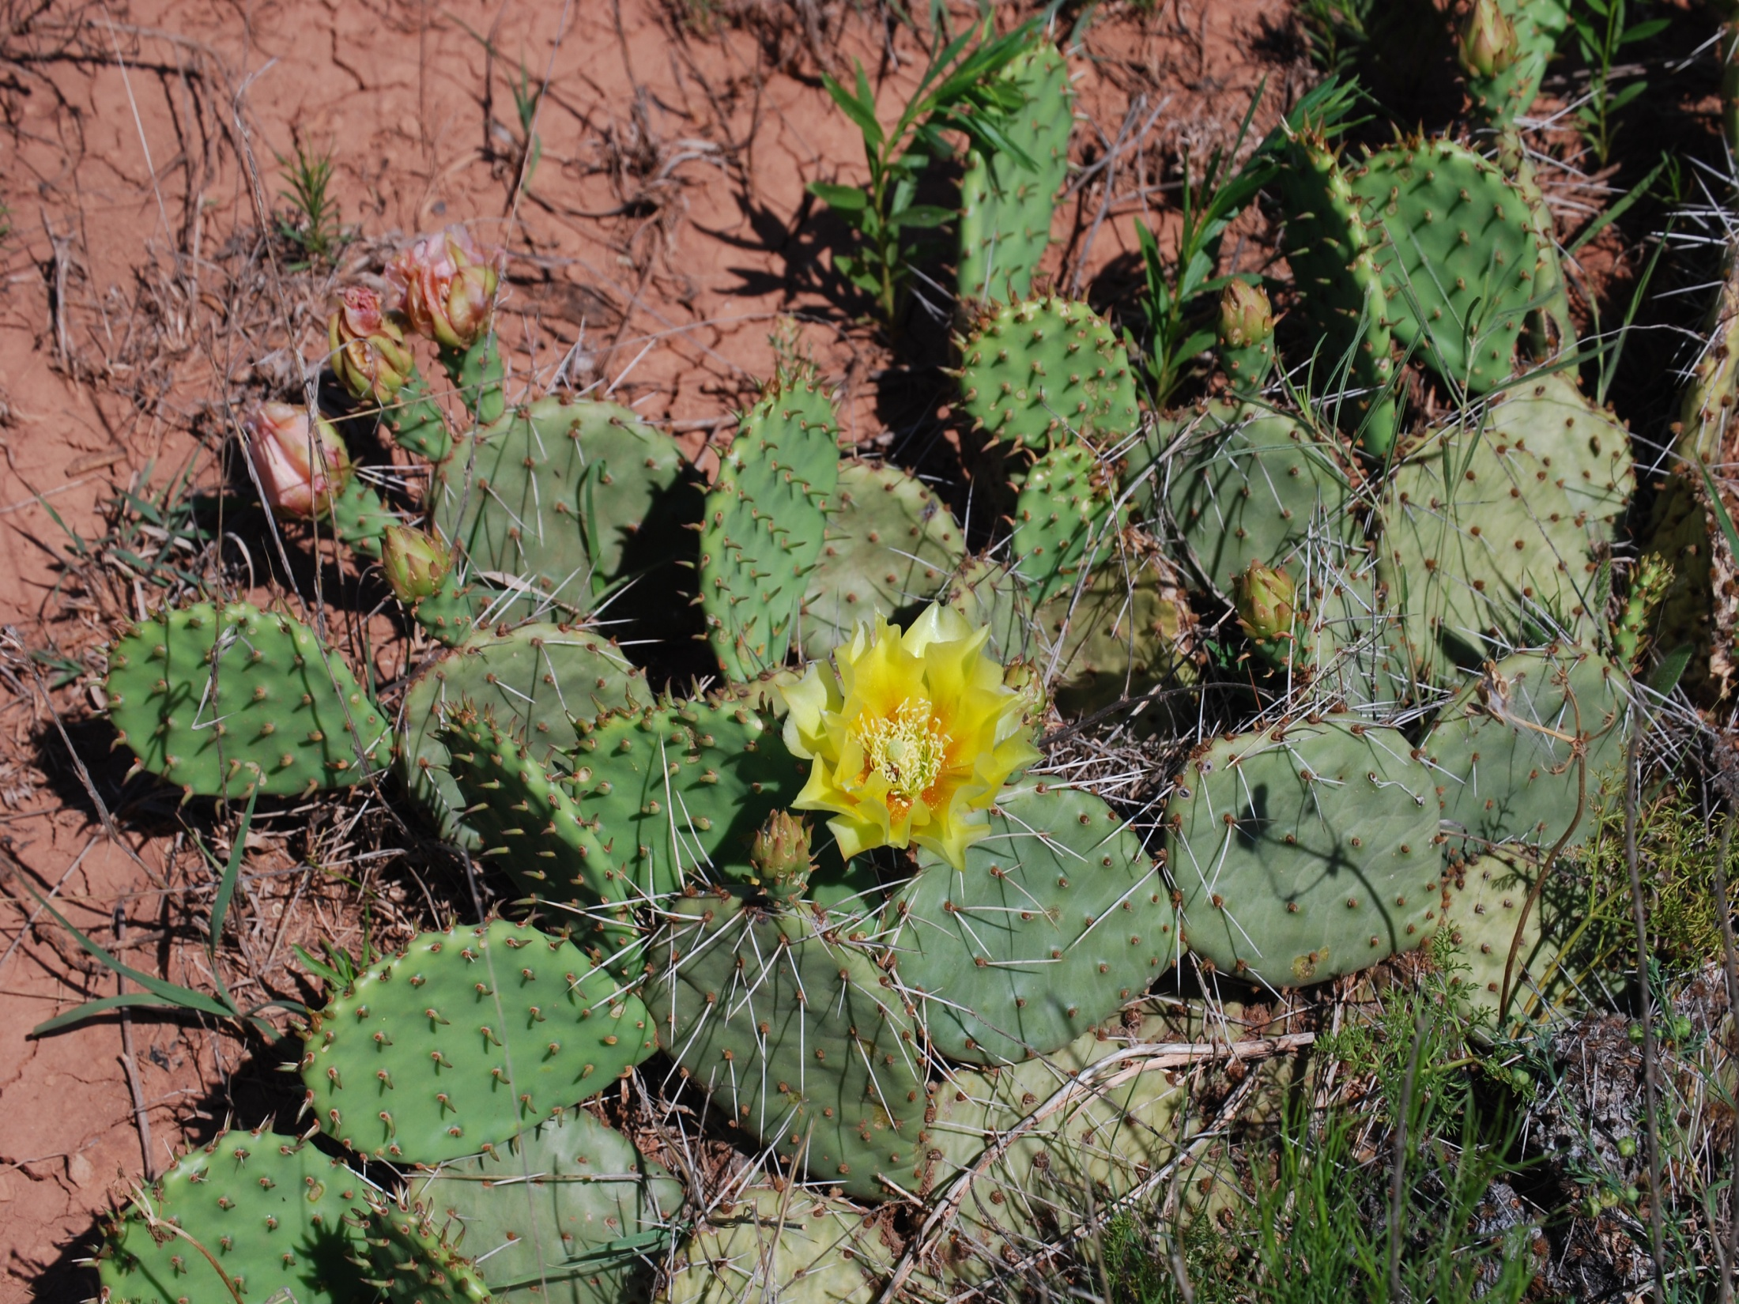
PRICKLY PEAR CACTUS
Photo Provided by Courtney Pilkington

Slide 8
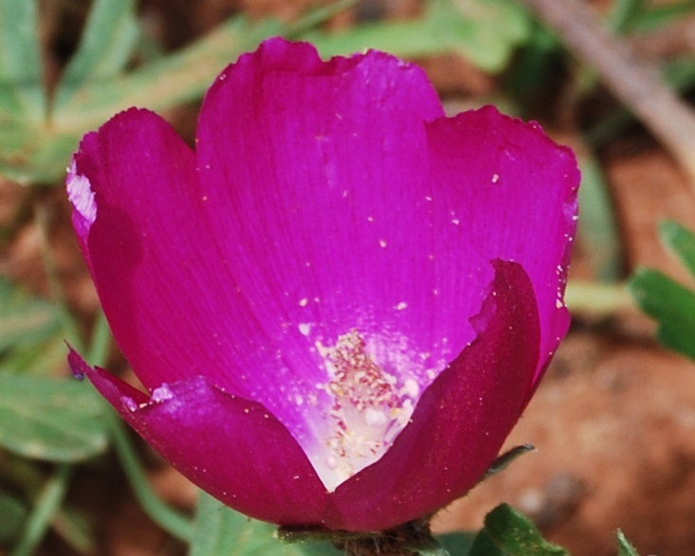
PURPLE POPPYMALLOW
Photo Provided by Courtney Pilkington

Slide 9
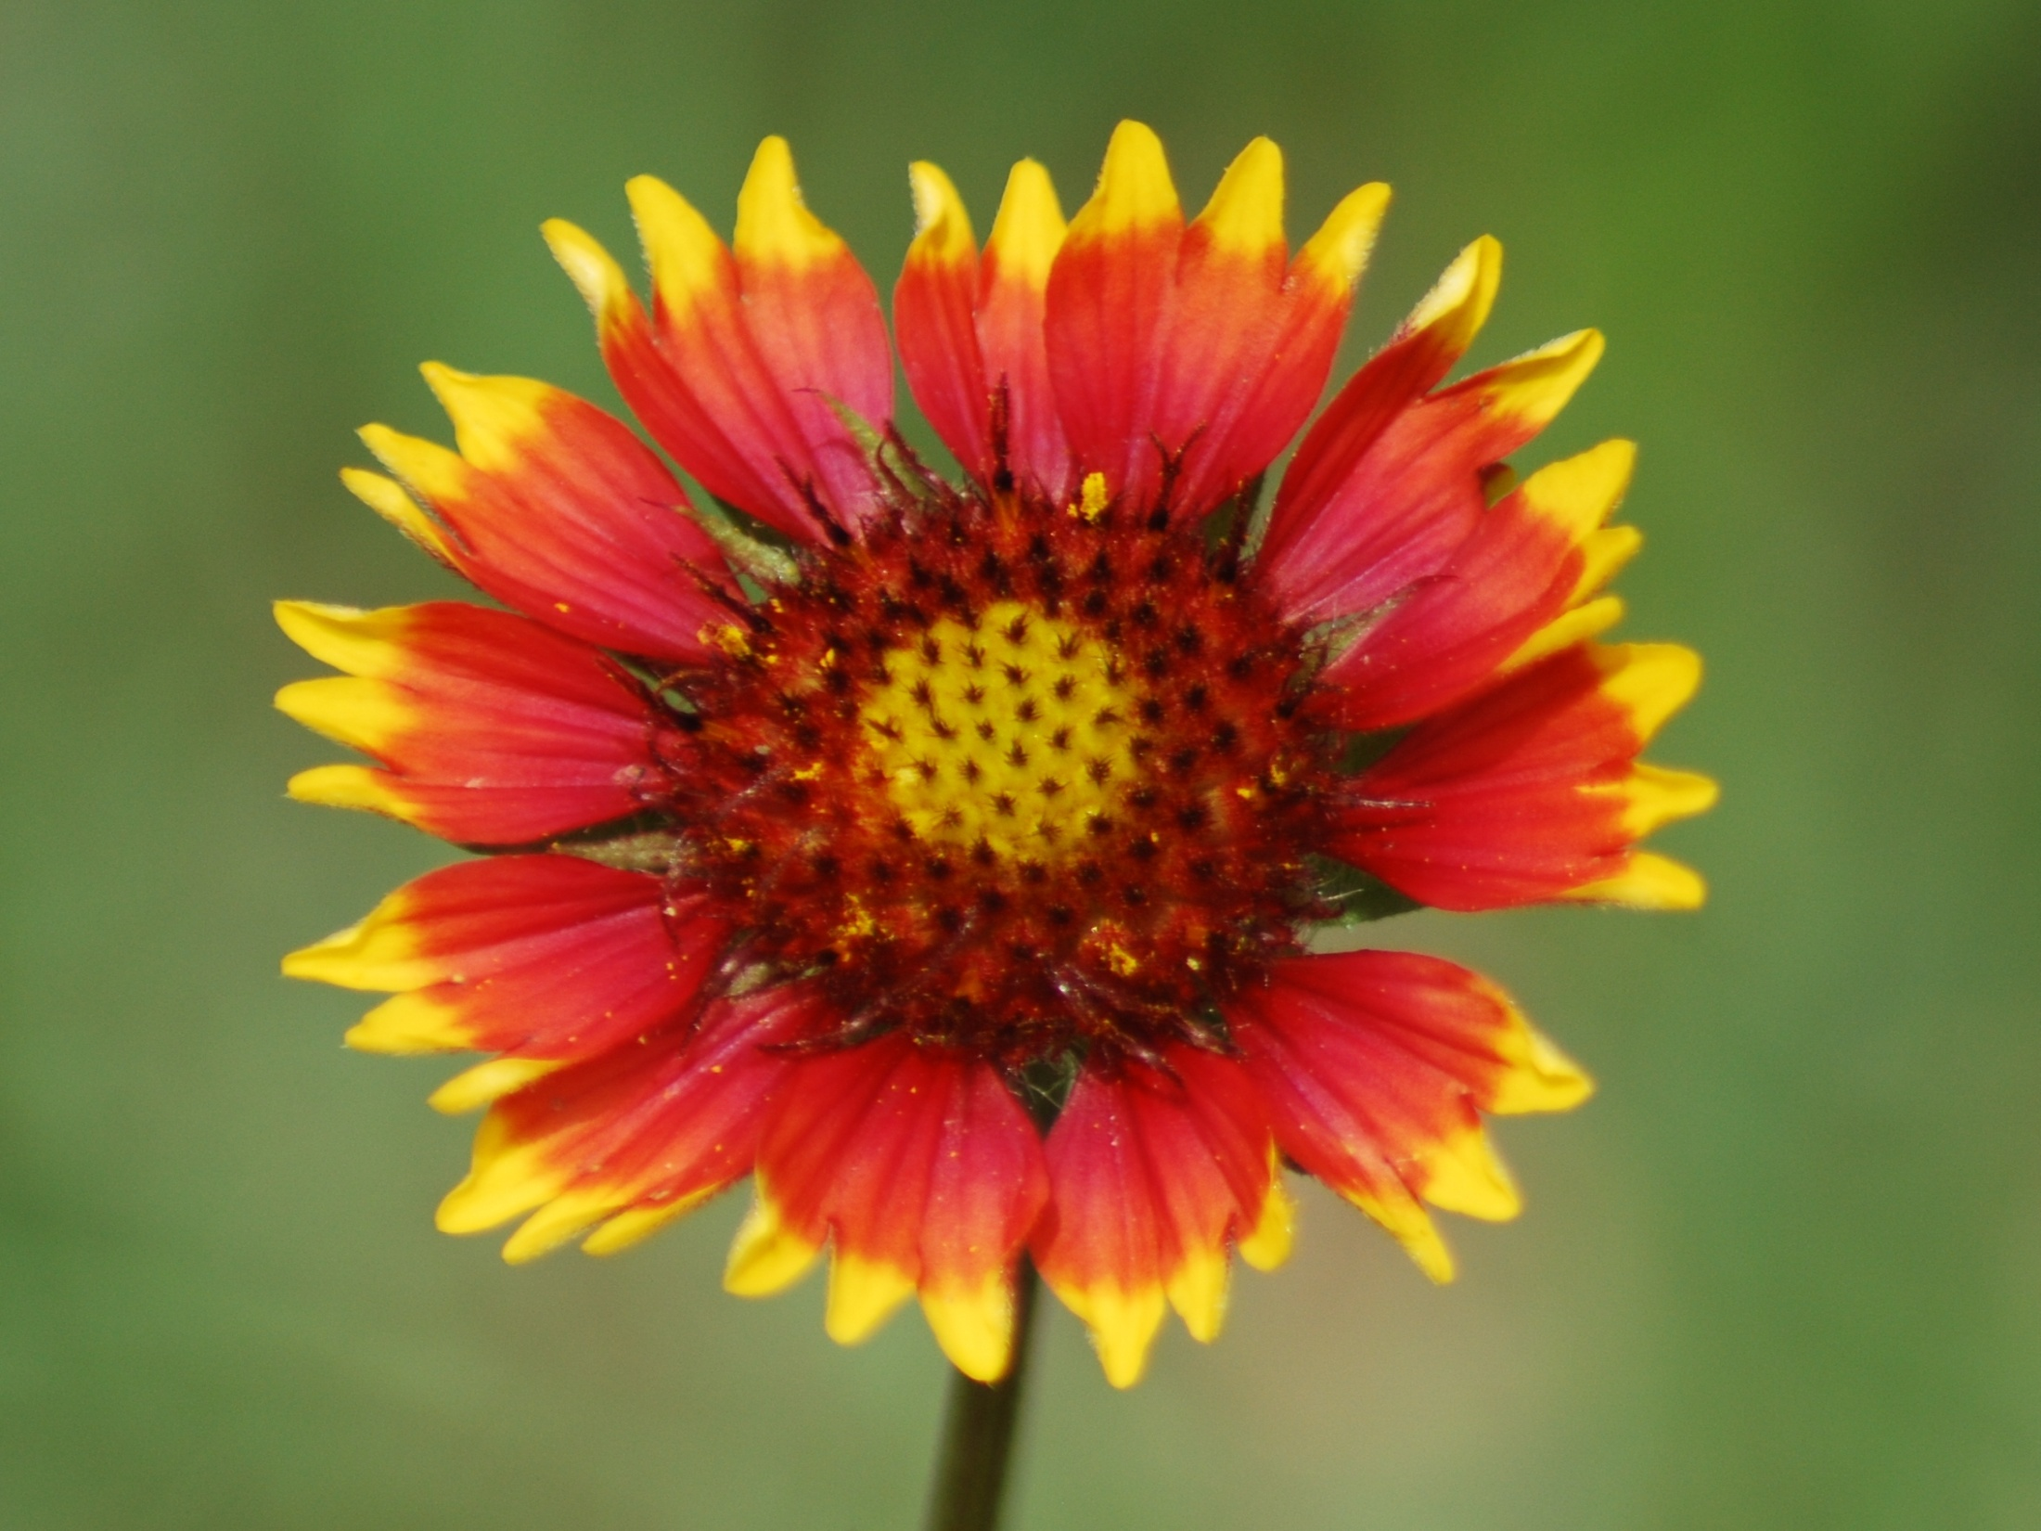
ROSERING GAILLARDIA
(INDIAN BLANKET)
Photo Provided by Courtney Pilkington

Slide 10
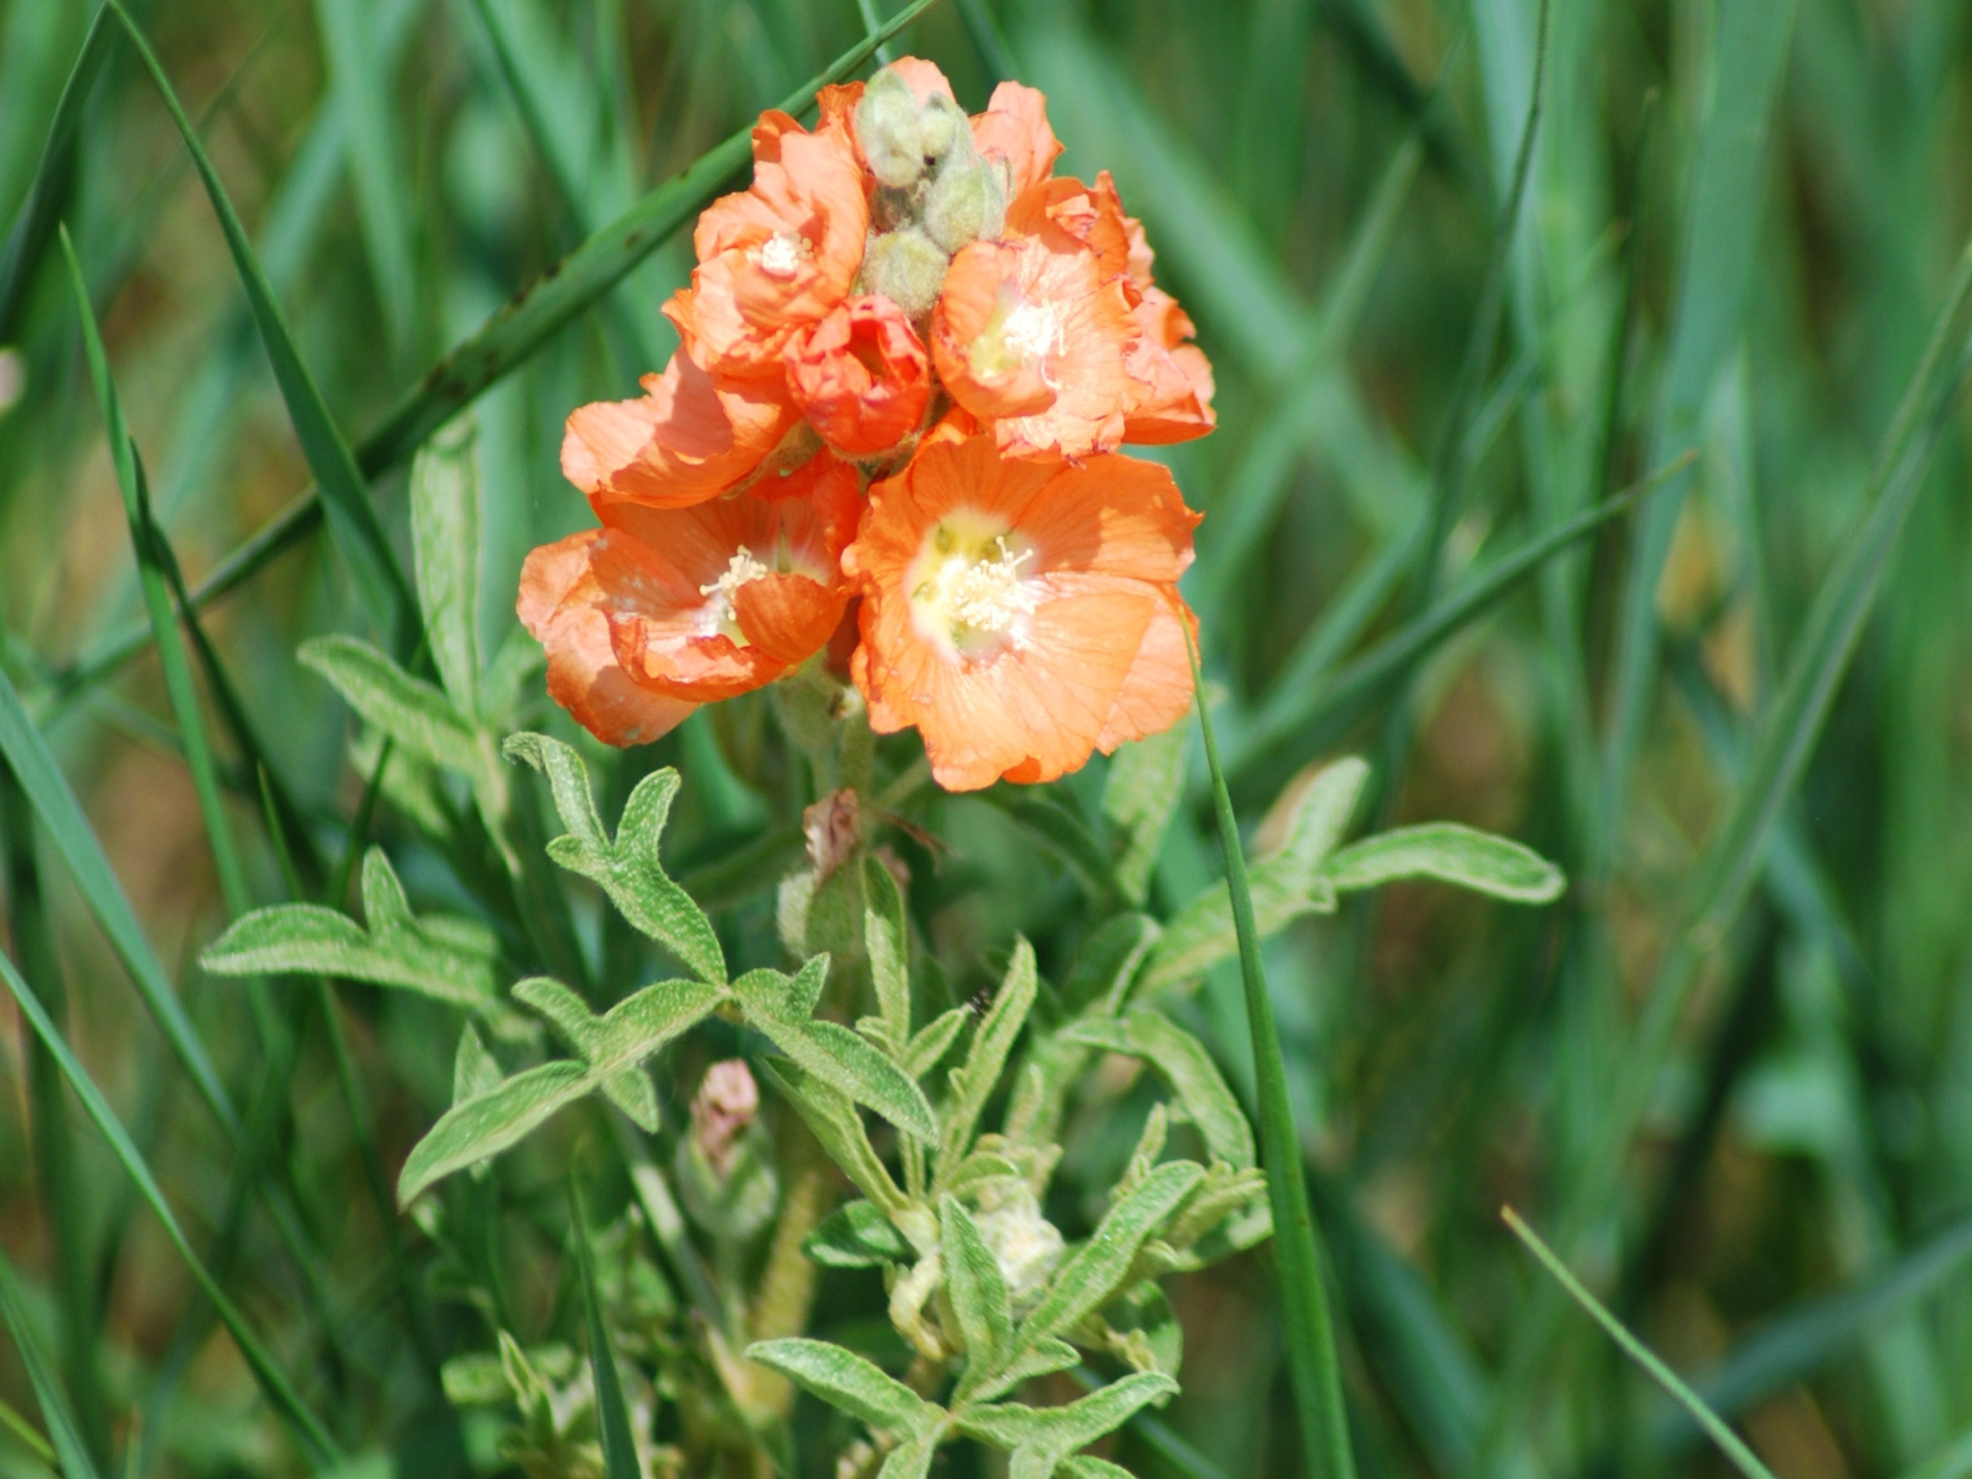
SCARLET GLOBEMALLOW
Photo Provided by Courtney Pilkington

Slide 11
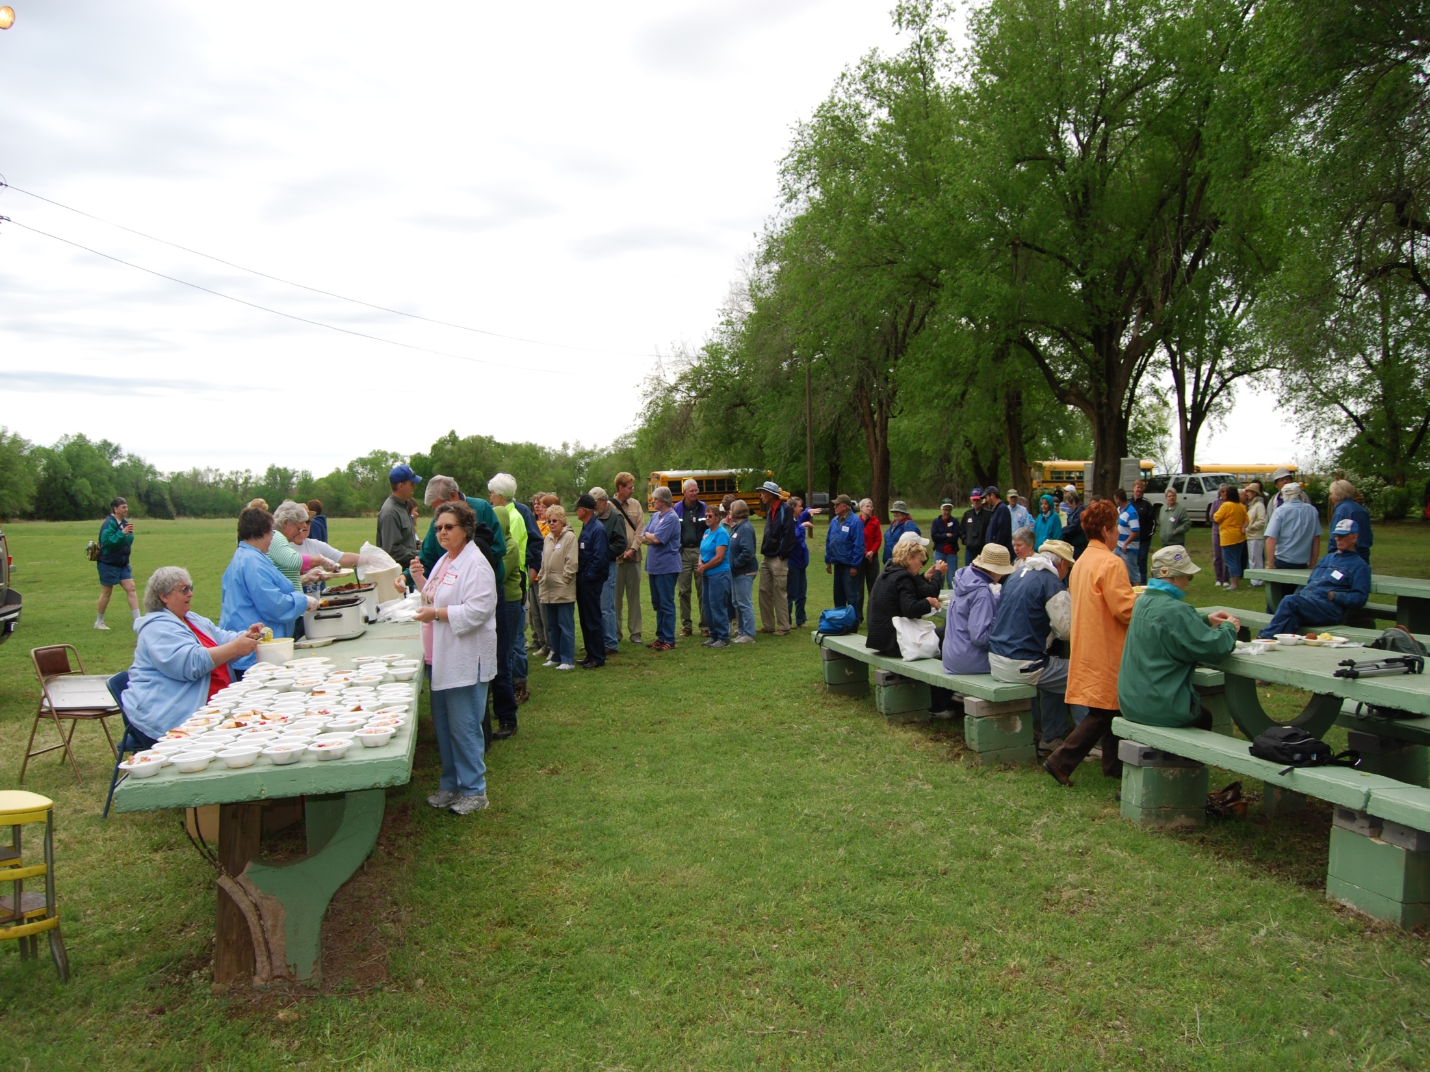
A Delicious BBQ Lunch is Served at Eagle Park!! Be Sure to Keep Your Ticket For Door Prizes!!
Photo Provided by Courtney Pilkington

Slide 12
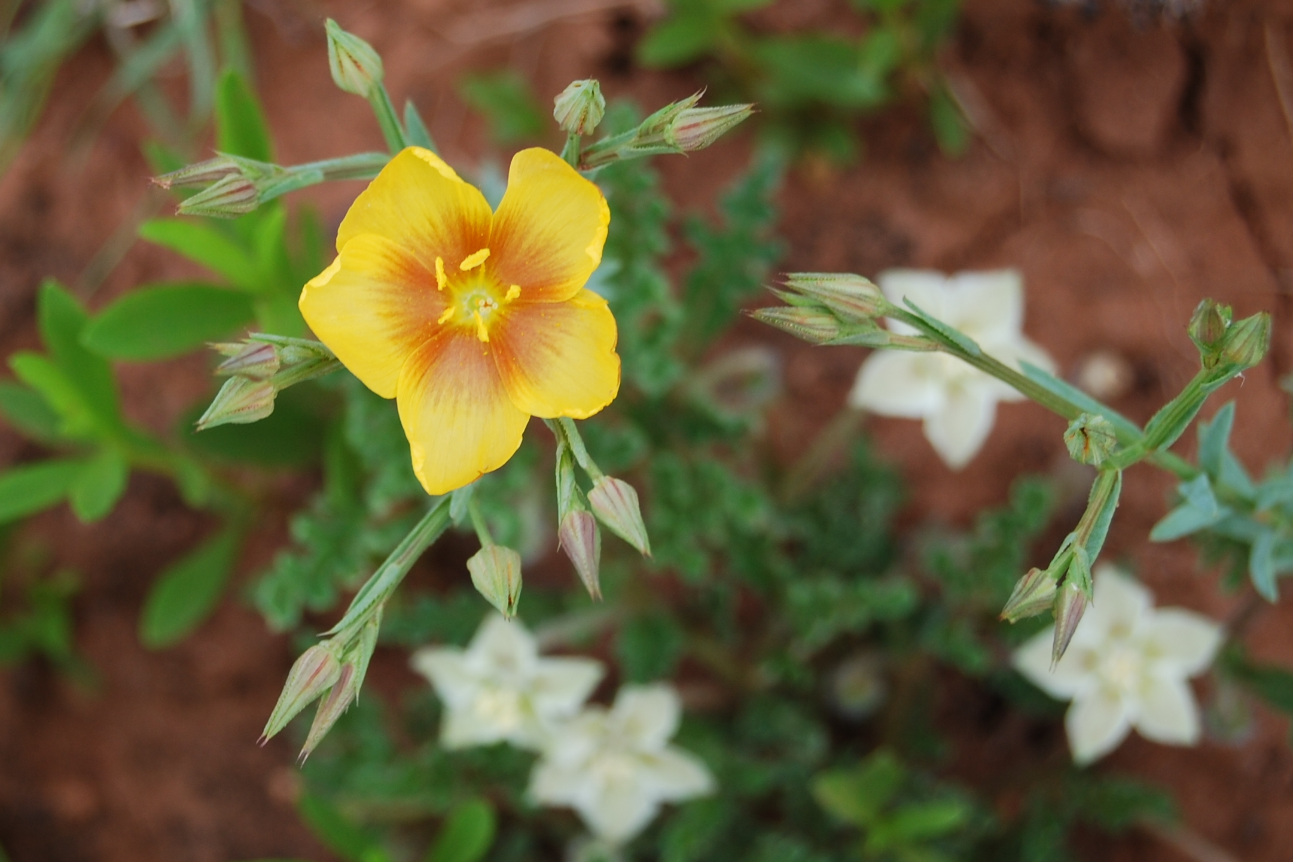
After Lunch, It’s Off to a Second Site for More Wildflowers!
Photo Provided by Courtney Pilkington

Slide 13
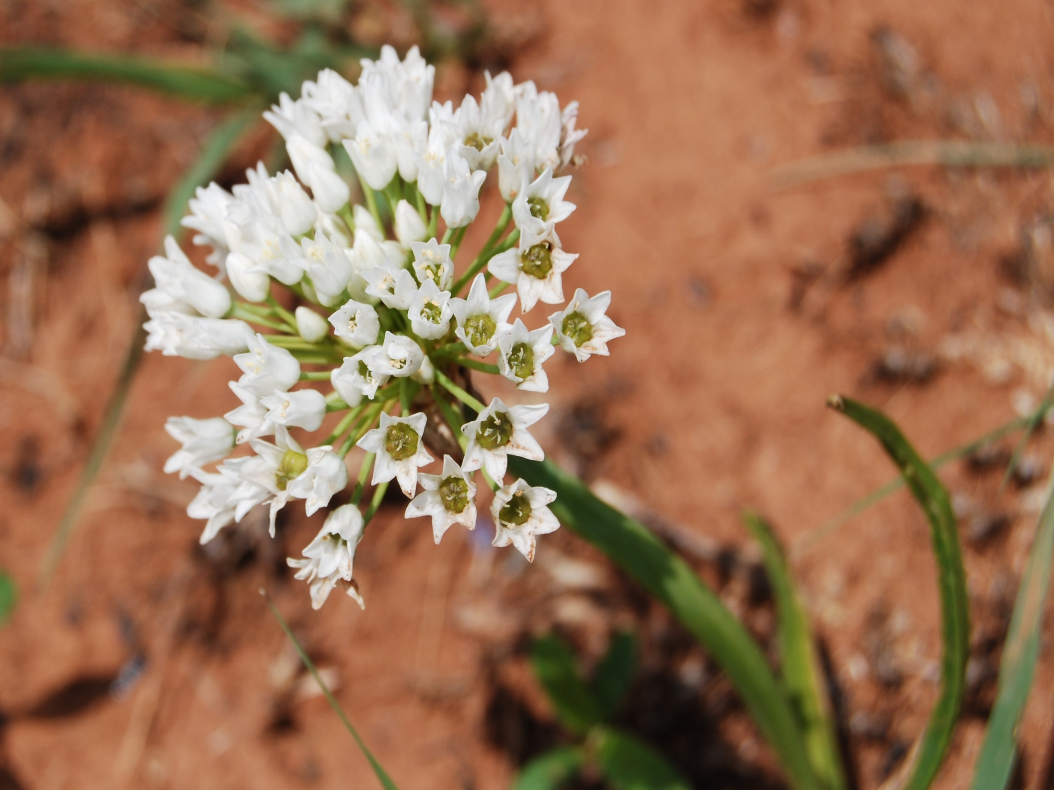
WILD ONION
Photo Provided by Courtney Pilkington

Slide 14
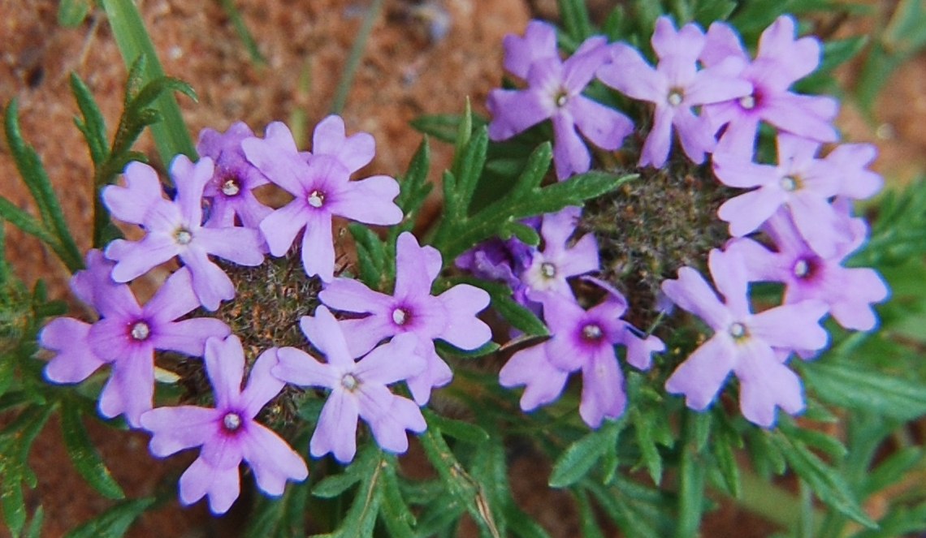
DAKOTA VERBENA
Photo Provided by Courtney Pilkington

Slide 15
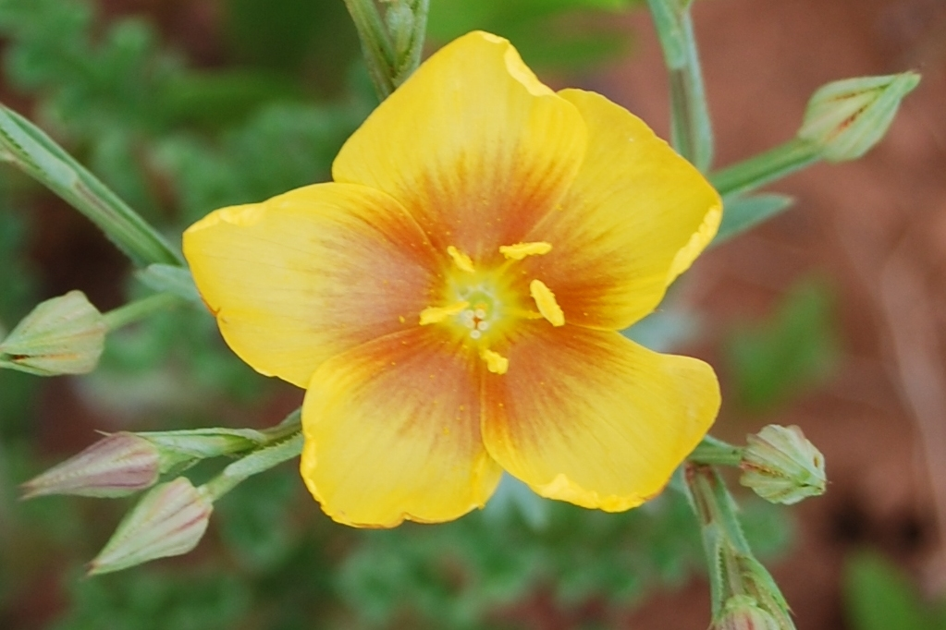
STIFF STEM FLAX
Photo Provided by Courtney Pilkington

Slide 16
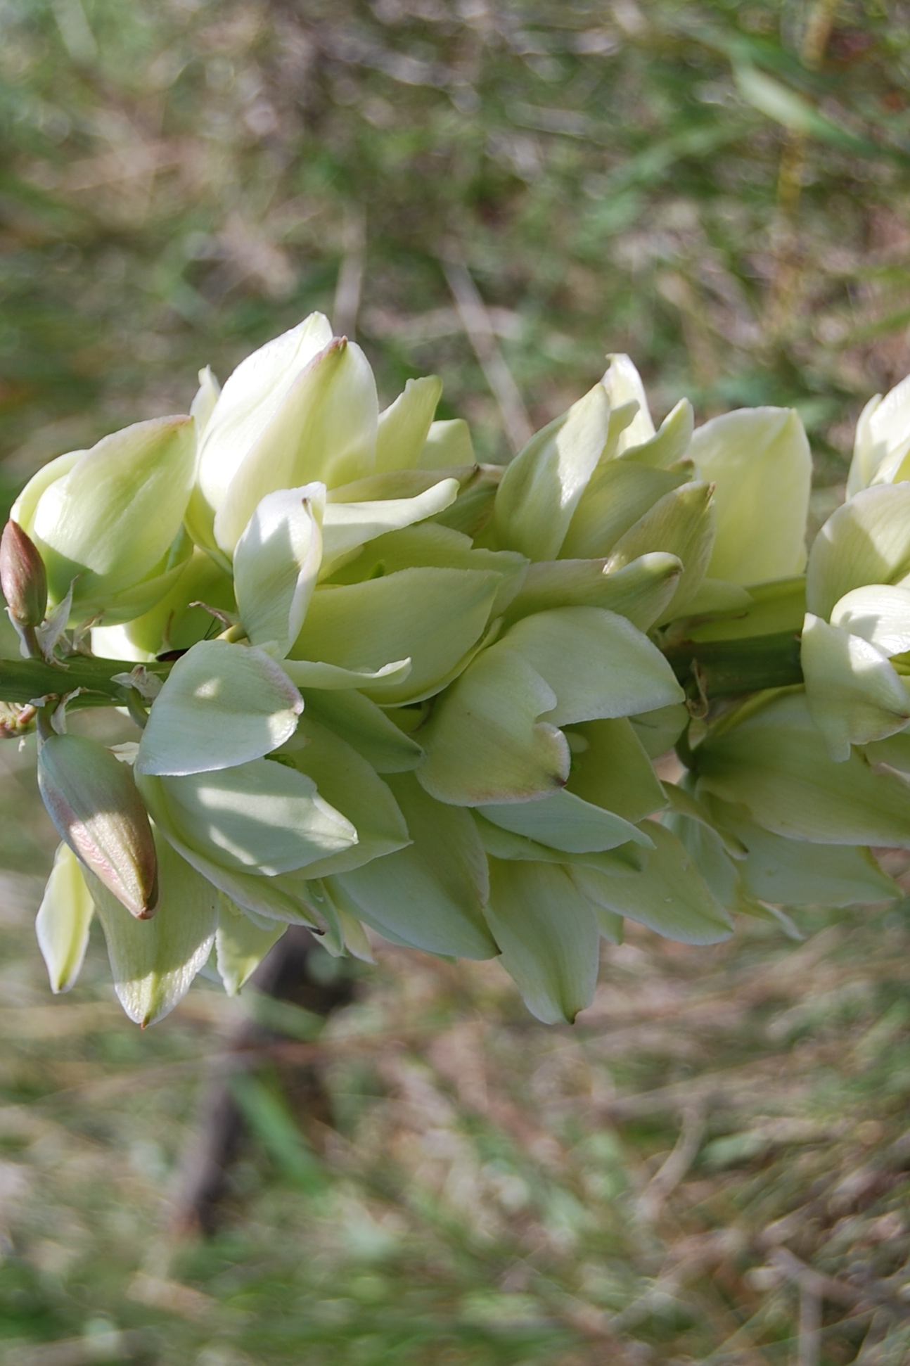
SMALL SOAPWEED (YUCCA)
Photo Provided by Courtney Pilkington

Slide 17
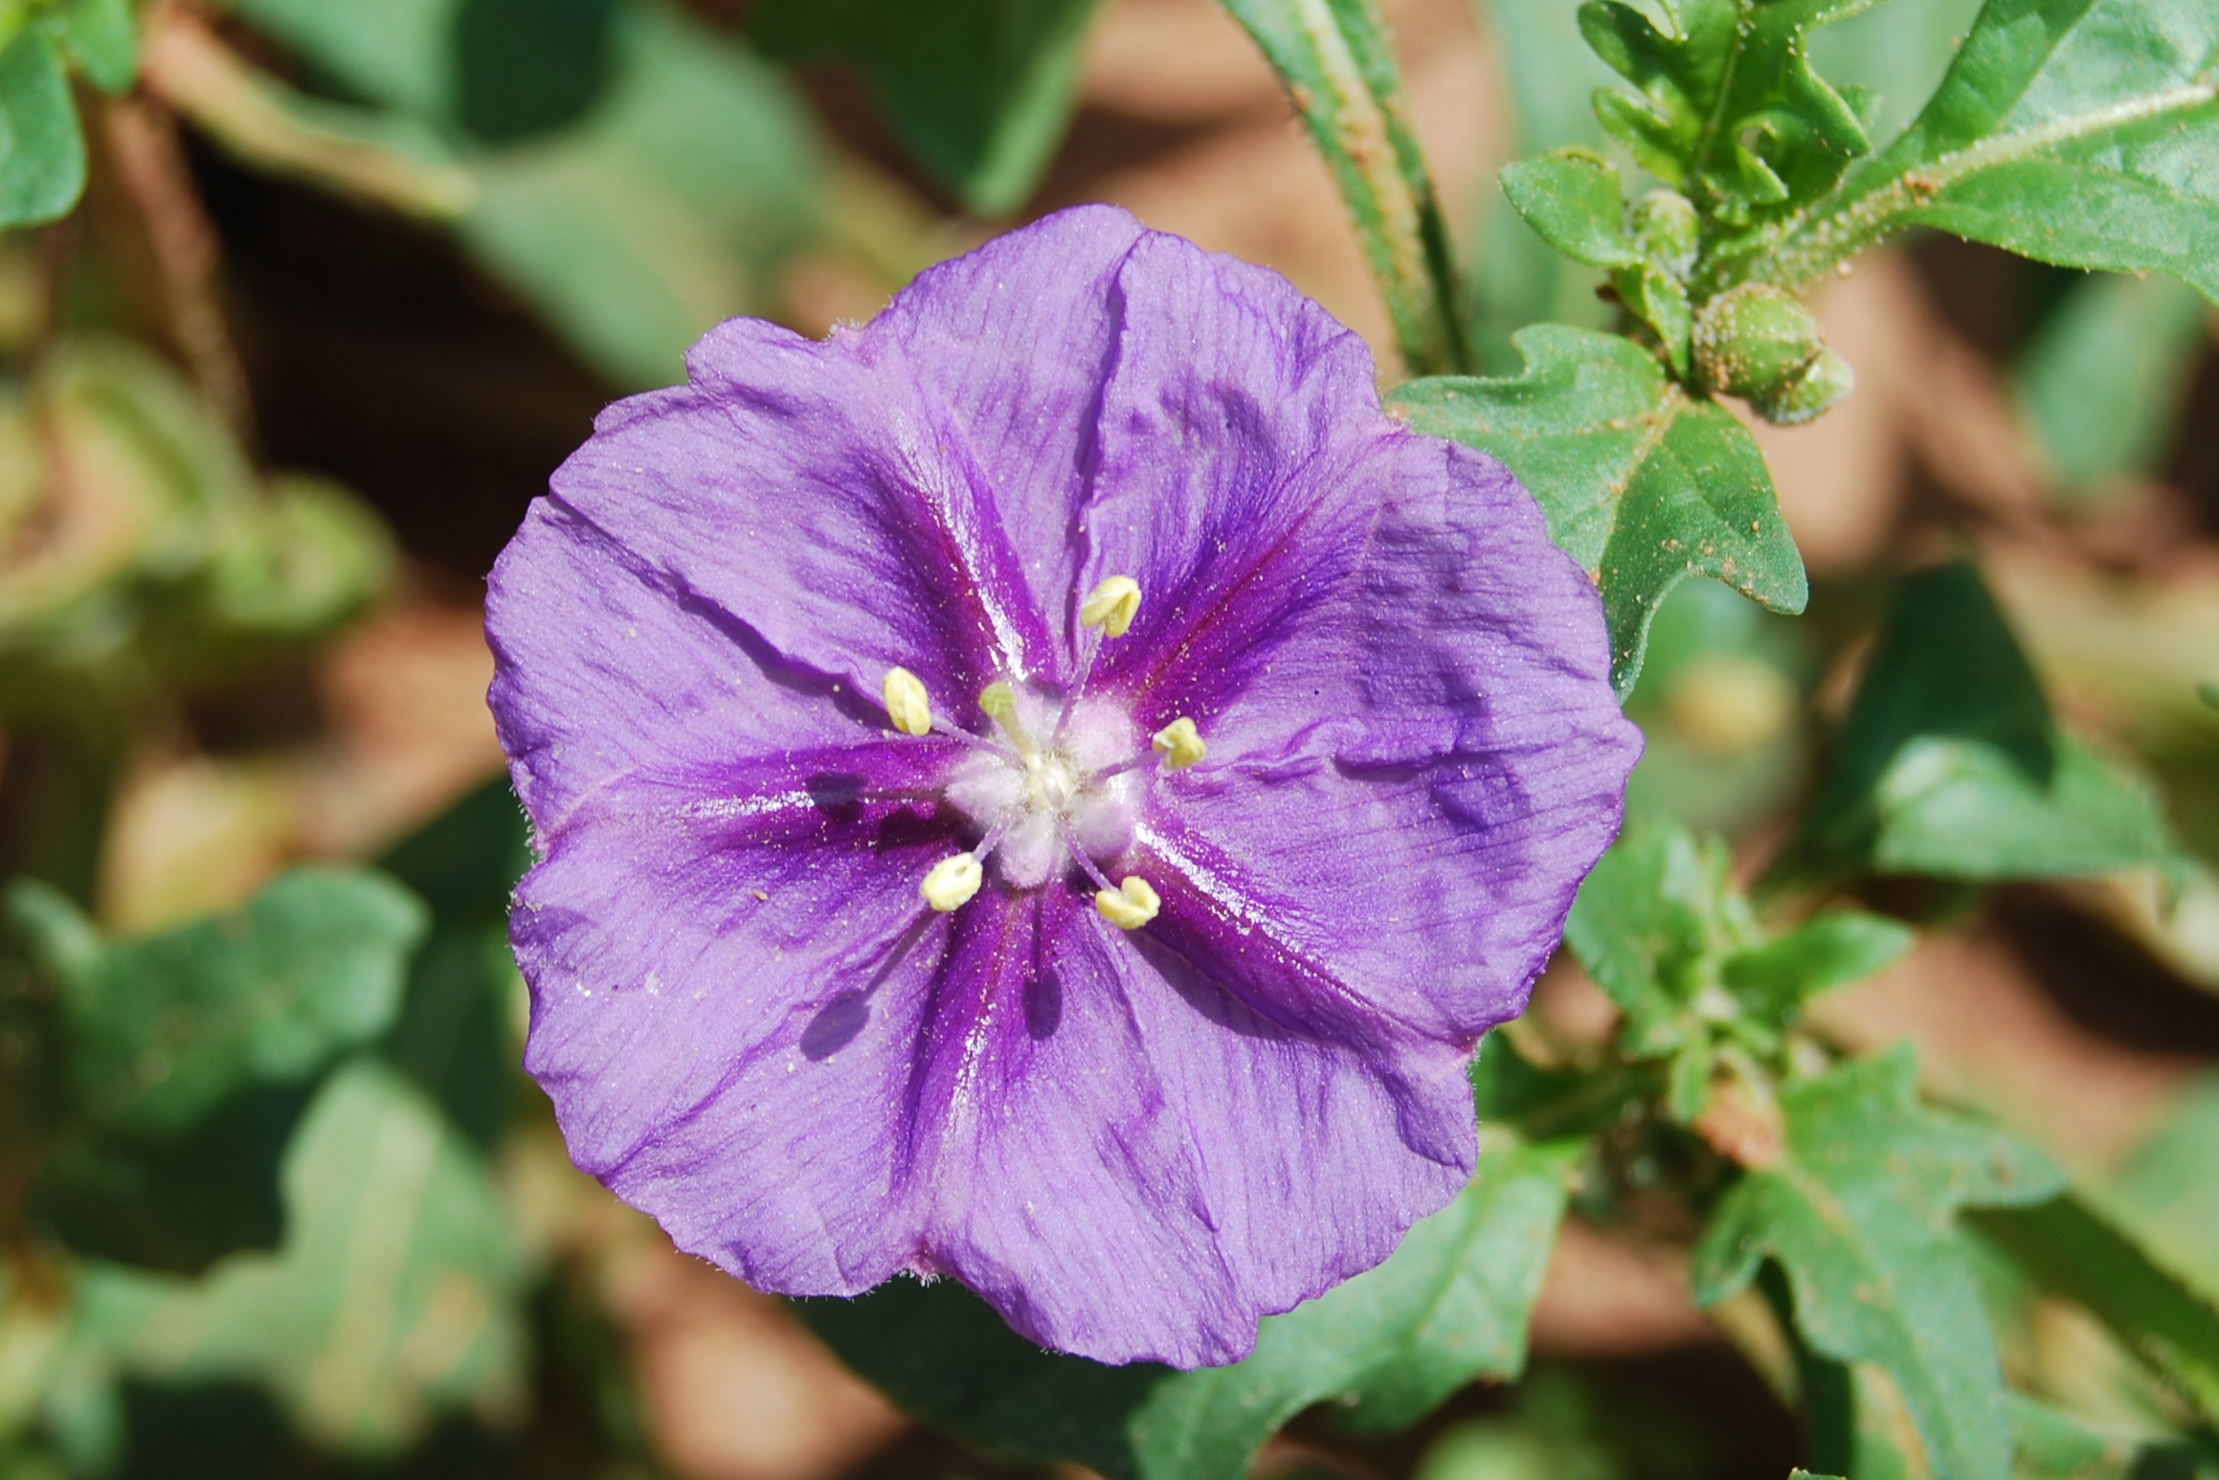
PLAINS CHINESE LANTERN
(GROUND CHERRY)
Photo Provided by Courtney Pilkington

Slide 18
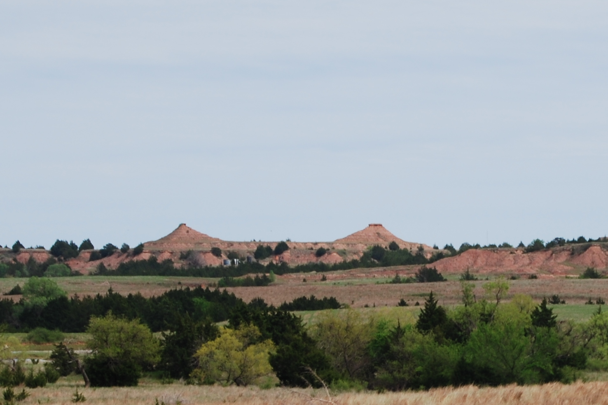
After Refreshments, It’s Back on the Bus for A Stunning Trip Through the Gyp Hills Arriving Back in Town Around 3:30 p.m.
Photo Provided by Courtney Pilkington

Slide 19
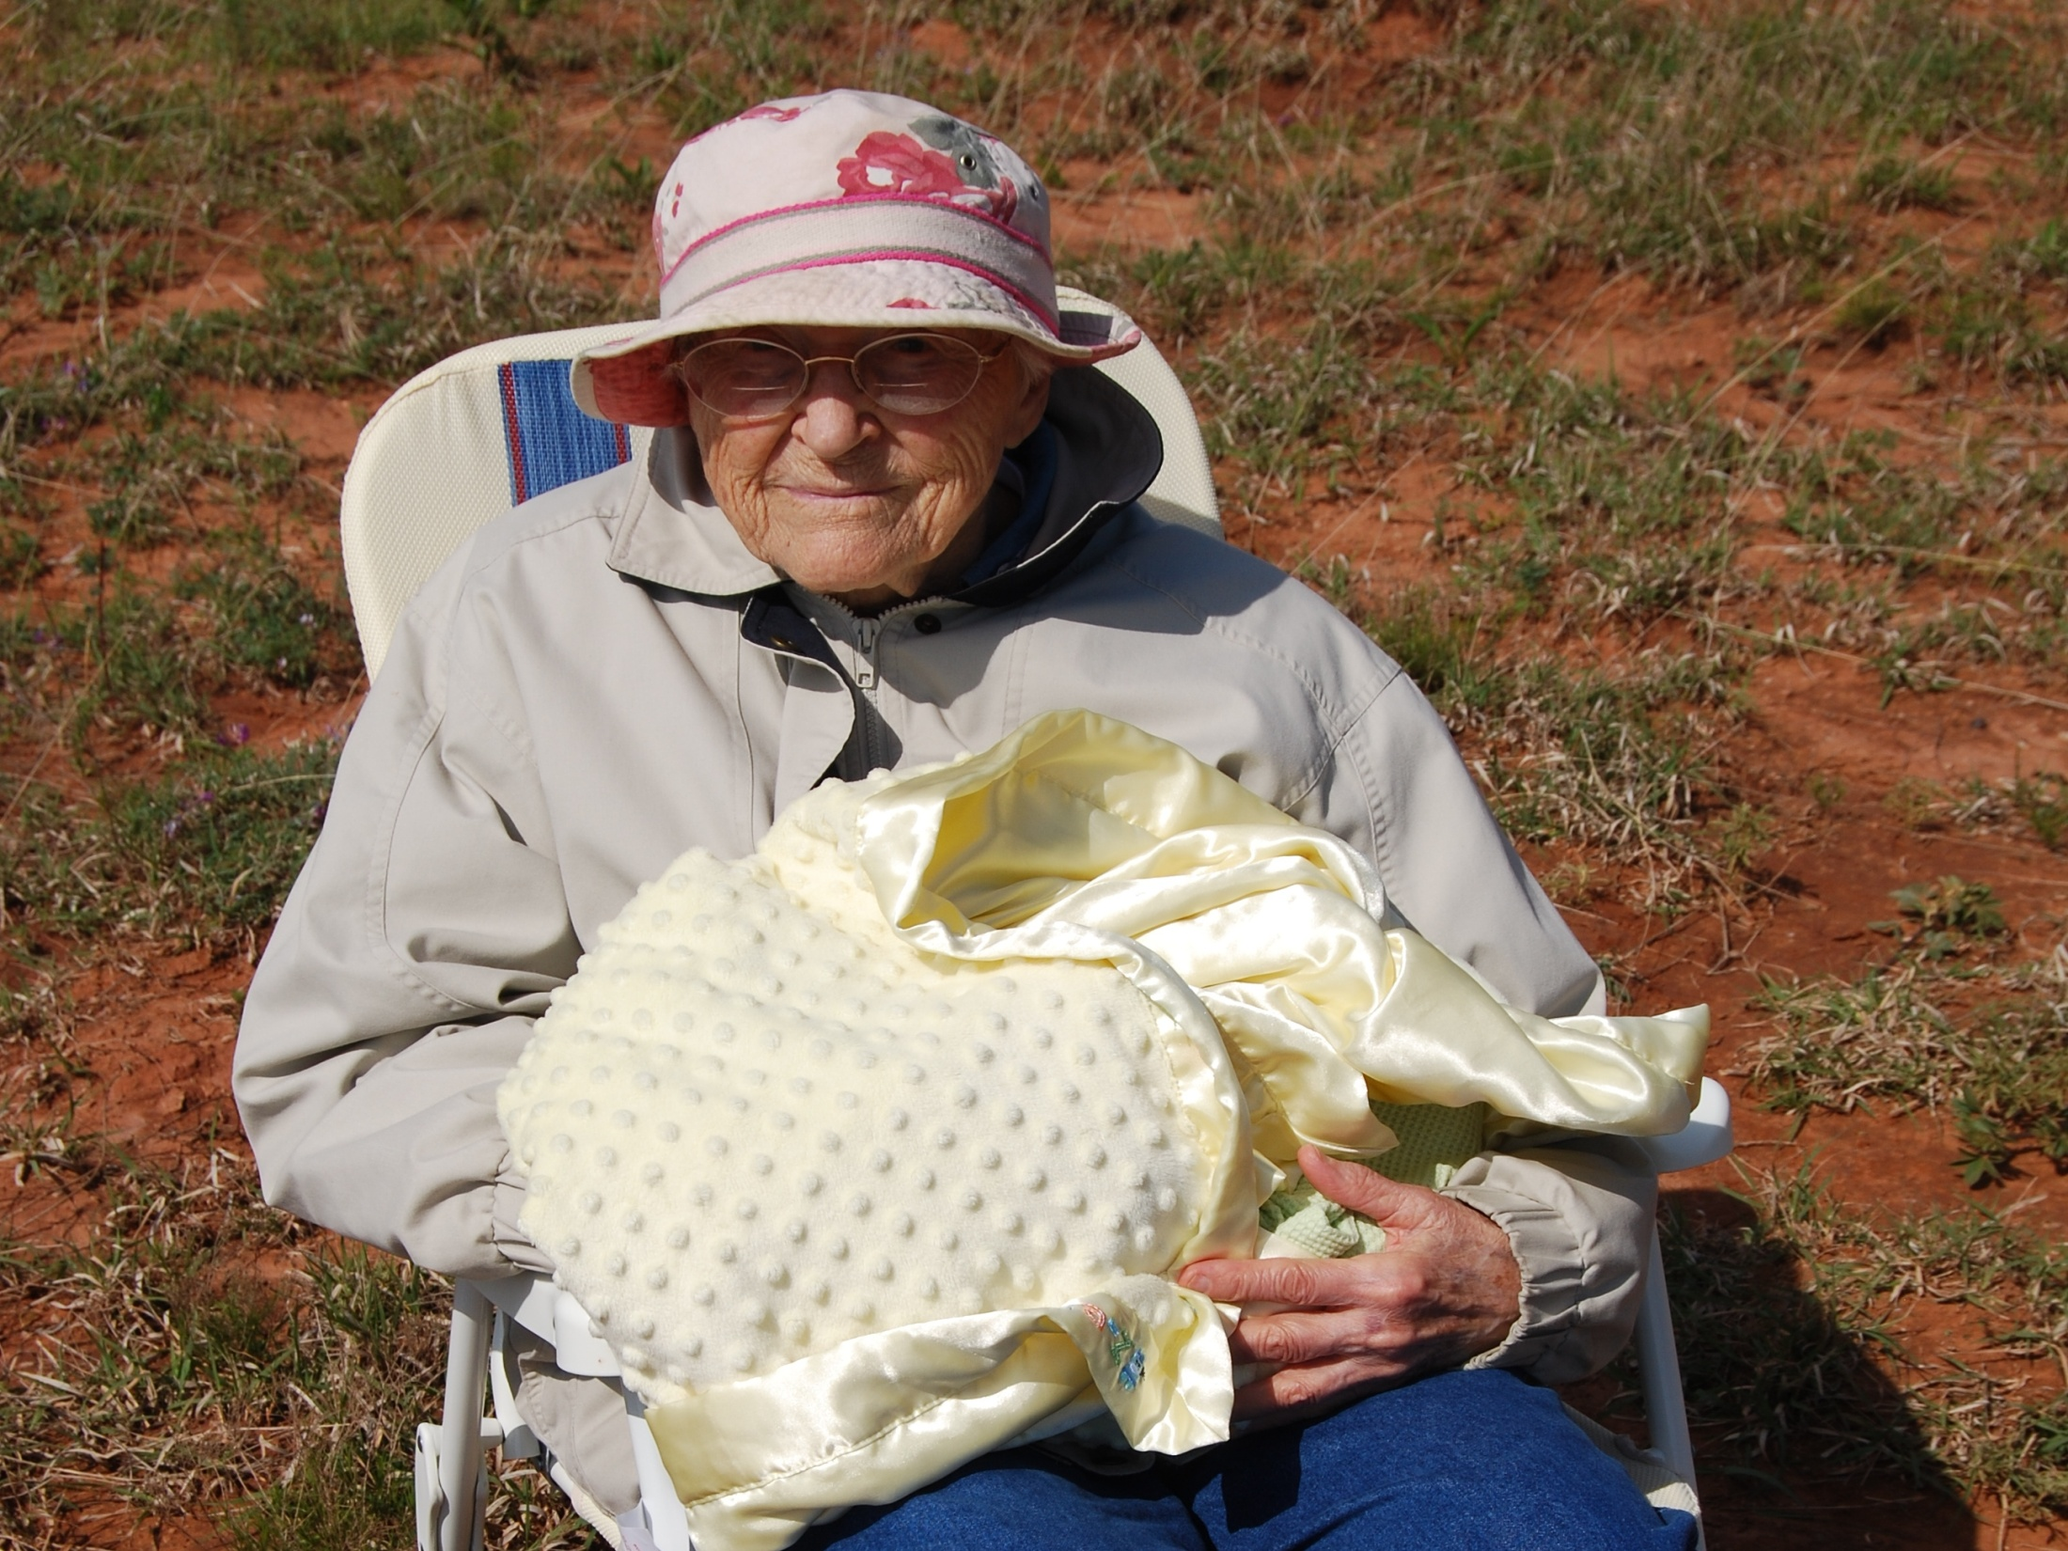
There is Some Walking Involved, but the Day Can Be Enjoyed by People of ALL Ages!
From 9 Days to 94 Years!!
Photo Provided by Courtney Pilkington

Slide 20
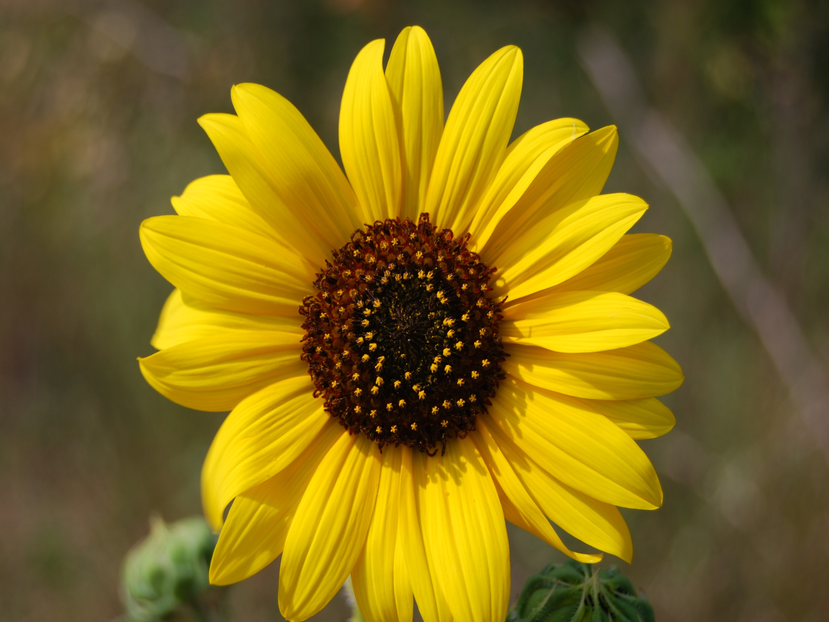
Tour Cost is $15
Children Under 10 are Free
Paid Reservations are Due by May 3, 2013
The Wildflower Tour is Held Rain or Shine.
Photo Provided by Courtney Pilkington

Slide 21
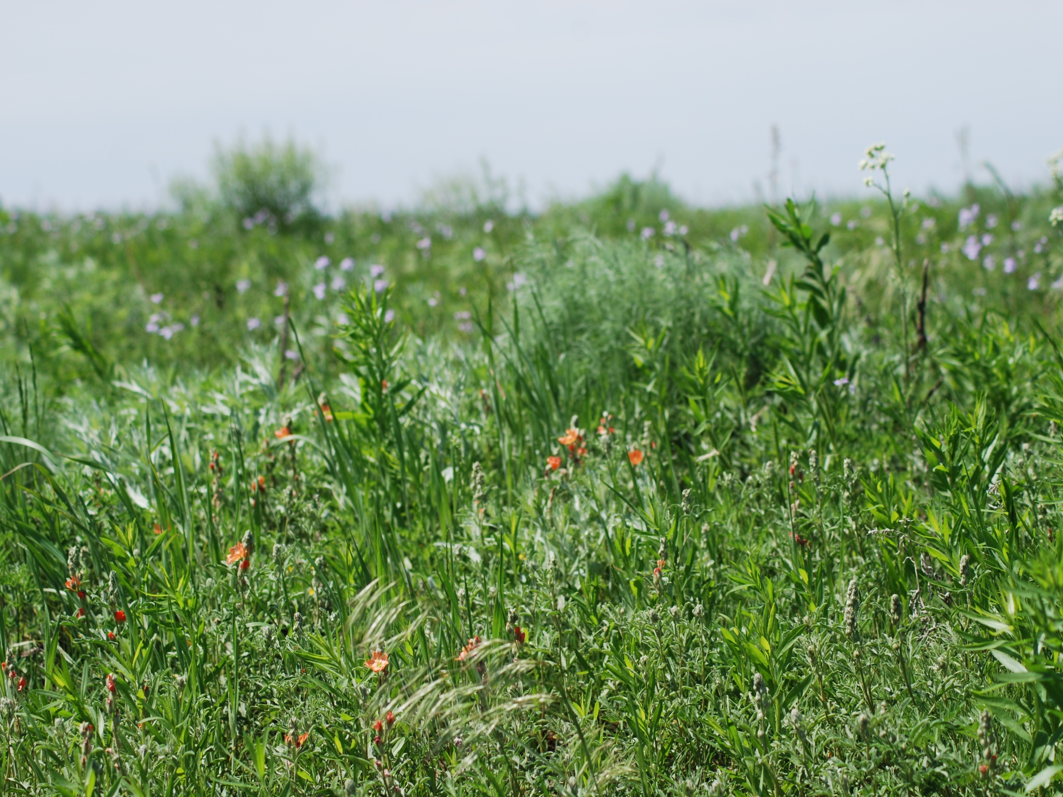
PHOTOS PROVIDED WITH PERMISSION BY
COURTNEY PILKINGTON
&
THE BARBER COUNTY
CONSERVATION DISTRICT
Photo Provided by Courtney Pilkington

